Slide 1


Introduction to IDEs and Java
This presentation provides an overview of Integrated Development Environments (IDEs) and the Java programming language. We will explore the key features of IDEs, popular examples, and the core components of Java.
by Muhammad Qaiser Bashir

Slide 2

What is an IDE?
Definition
Key Features
An Integrated Development Environment (IDE) provides comprehensive facilities to computer programmers for software development.
It combines a source code editor, build automation tools, and a debugger in a single, unified interface.
Purpose
The primary aim of an IDE is to increase developer productivity by streamlining the development process.

Slide 3

Popular IDE Examples
Eclipse
IntelliJ IDEA
An open-source and extensible IDE that supports multiple programming languages.
A commercial IDE focused on developer productivity and smart code completion.
Visual Studio
Android Studio
Microsoft's IDE that supports various languages, including C#, Python, and JavaScript.
Specifically designed for Android app development.

Slide 4
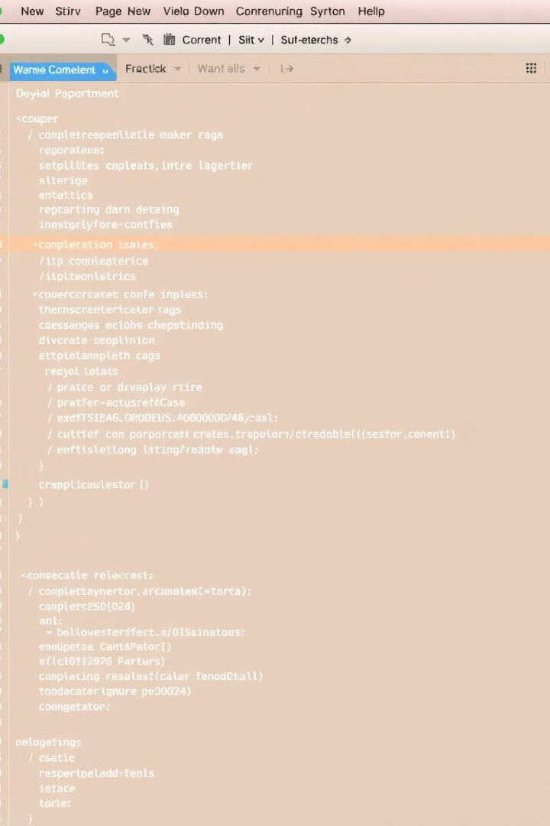




Key Features of IDEs
Code Completion
Syntax Highlighting
Debugging Tools
Suggests code snippets, reducing typing errors and improving speed.
Uses colors to differentiate code elements, improving readability.
Helps identify and fix errors via breakpoints and variable inspection.
Refactoring
Streamlines code structure without changing functionality.

Slide 5
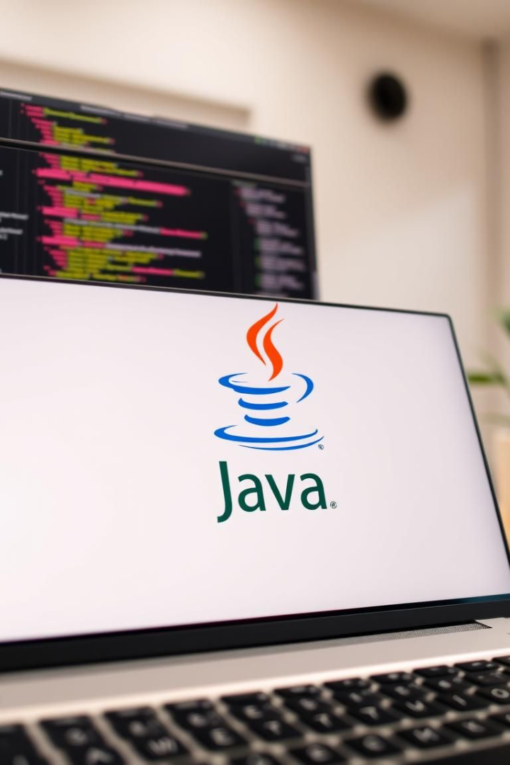



Introduction to Java
Definition
A high-level, class-based, object-oriented programming language.
Platform Independence
Designed to have as few implementation dependencies as possible.
Usage
Widely used for enterprise applications and Android development.

Slide 6
Java Components
JDK
JRE
JVM
Java Development Kit contains tools needed to develop, compile, and debug Java code.
Java Runtime Environment provides the minimum requirements for executing Java applications.
Java Virtual Machine enables a computer to run Java programs.

Slide 7





Core Java Concepts
OOP
1
Object-Oriented Programming.
Classes
2
Blueprints for creating objects.
Data Types
3
Primitive and reference types.
Control Flow
4
Conditional statements and loops.
Exception
5
Managing runtime errors.

Slide 8
Advantages of Using Java
Platform
1
Write Once, Run Anywhere.
Object
2
Supports modularity.
Large
3
Extensive libraries.
Robust
4
Automatic garbage collection.

Slide 9



IDEs for Java Development
Eclipse
2
Versatile and open-source.
IntelliJ IDEA
1
Advanced code completion.
NetBeans
3
Integrated tools designed for Java.

Slide 10

Conclusion
Enhancement
Popular
IDEs significantly enhance productivity by providing a comprehensive toolset.
Java's platform independence and robust features make it a popular choice.
Efficient
Combining Java with an IDE creates a productive development environment.

